Slide 1
Faber
The next generation of food recommending system
Presented by: Charles, Pearl, Rahul, Size

Slide 2

Agenda
Overview of Project
Local and Global Impact
Continuing Professional Development
Skills and Tools
Non-technical Discussion
Architecture
Development Methodology
Outside Classes

Slide 3
Project Overview

Slide 4
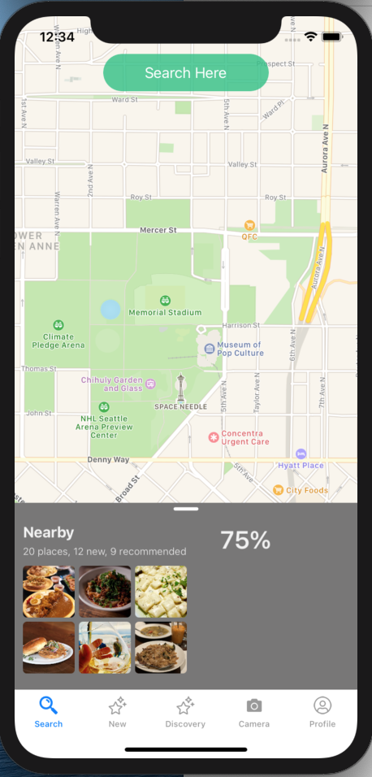

Project Overview
A food recommending Apps
Involves AI, Machine learning, Big data analysis
Your personal food consultant

Slide 5

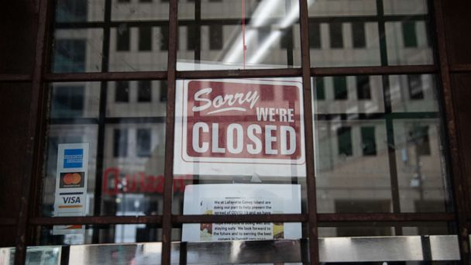
Why now? - Local and Global Impact
Covid-19 Pandemic
Small Restaurant
Algorithm centric
Easy to spread

Slide 6
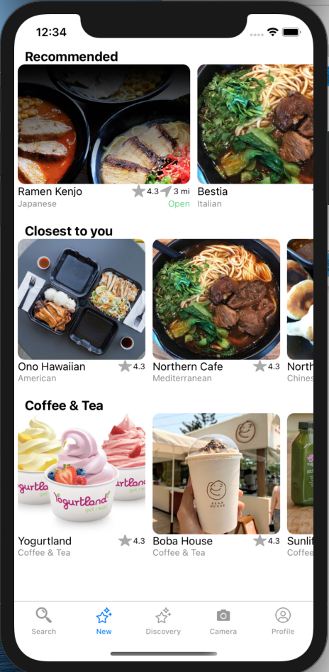
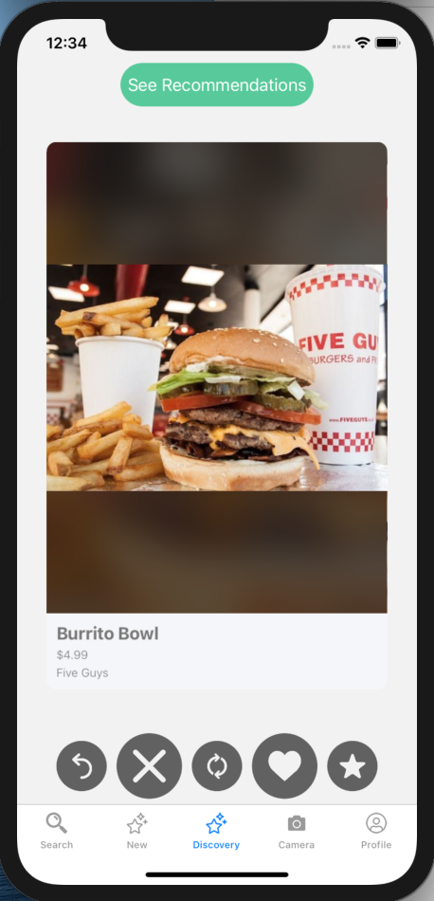
Product Images

Slide 7
Professional Development

Slide 8
Classes outside classes
CSCI 104 - algorithms
CSCI 201 - web development
CSCI 310 - software development principles
CSCI 566 - Deep Learning / Machine Learning
CSCI 360 - Artificial Intelligence
MATH 407 - Statistics for metrics
WRIT 340 - Documentation skills
BUAD 302 - Business Communication

Slide 9
Continuing Professional Development
IOS Development
Machine Learning
Recommendation Systems
Word2Vec Models (Gensim)
Cloud Database
NoSQL
Function as a Service

Slide 10




Skills and Tools
Flask
Rest API
Firestore
Google Authentication
AWS Lambda
Swift JSON
Machine Learning
Natural Language Processing

Slide 11
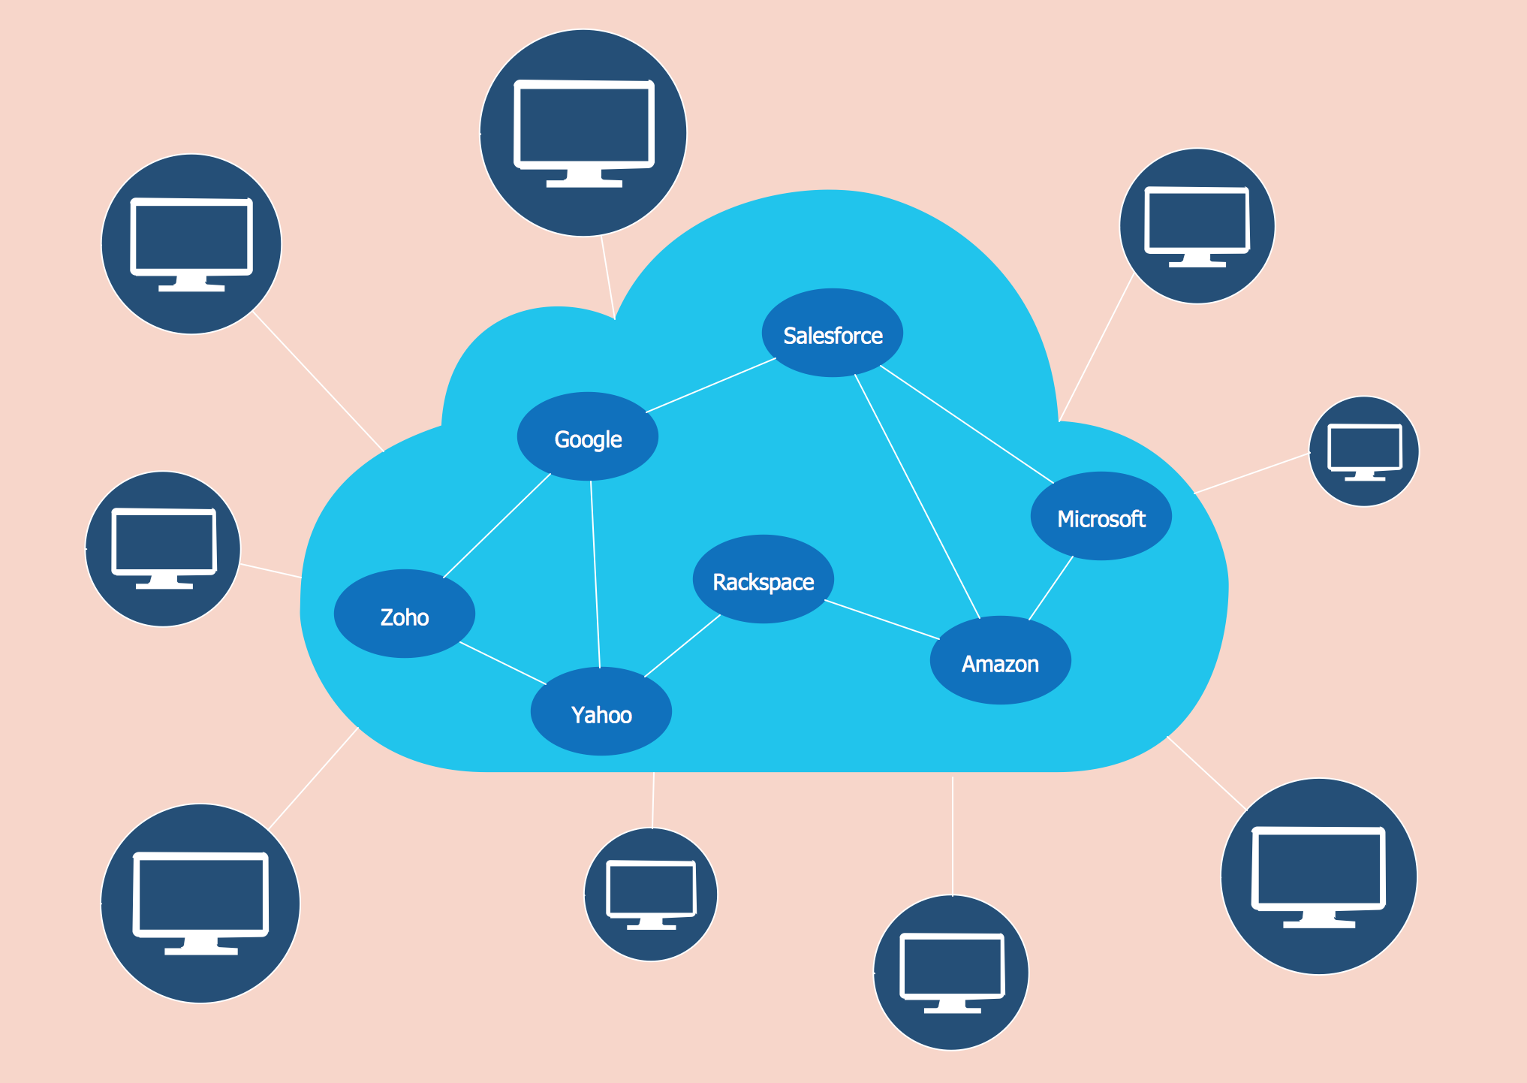
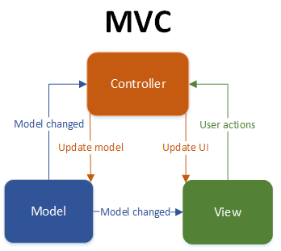
Architecture and design patterns
Model-View-Controller
REST
Cloud Native Structure
Collaborative Filtering
Word Embeddings (NLP)

Slide 12
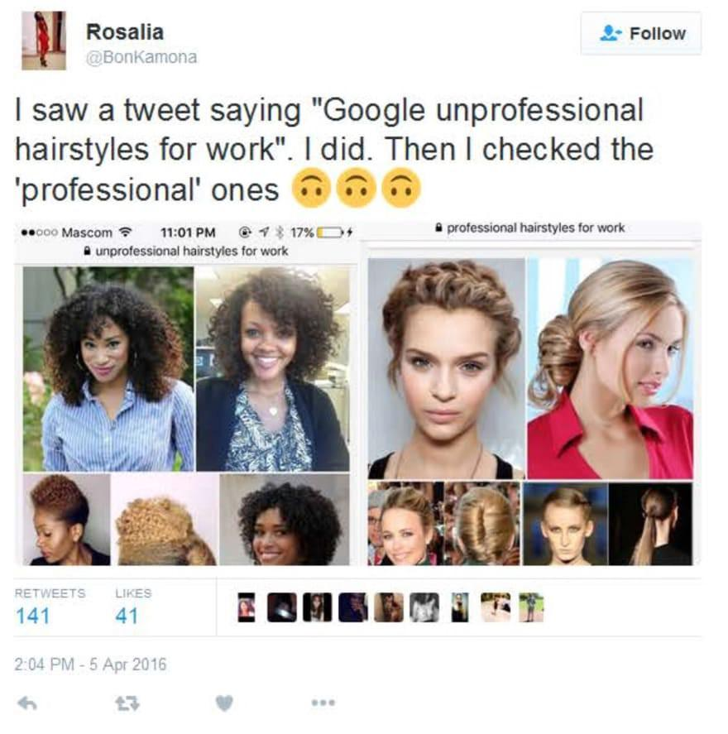

Non-Technical Discussion
Machine Learning bias
Focus on revenue model or user experience?

Slide 13
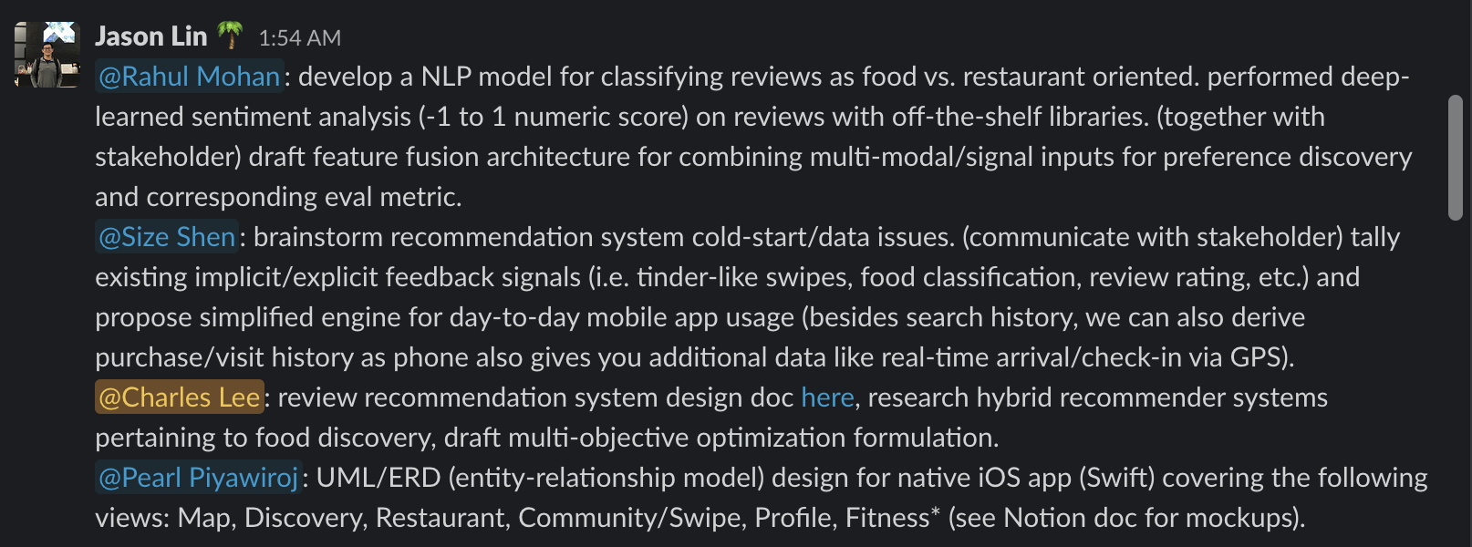
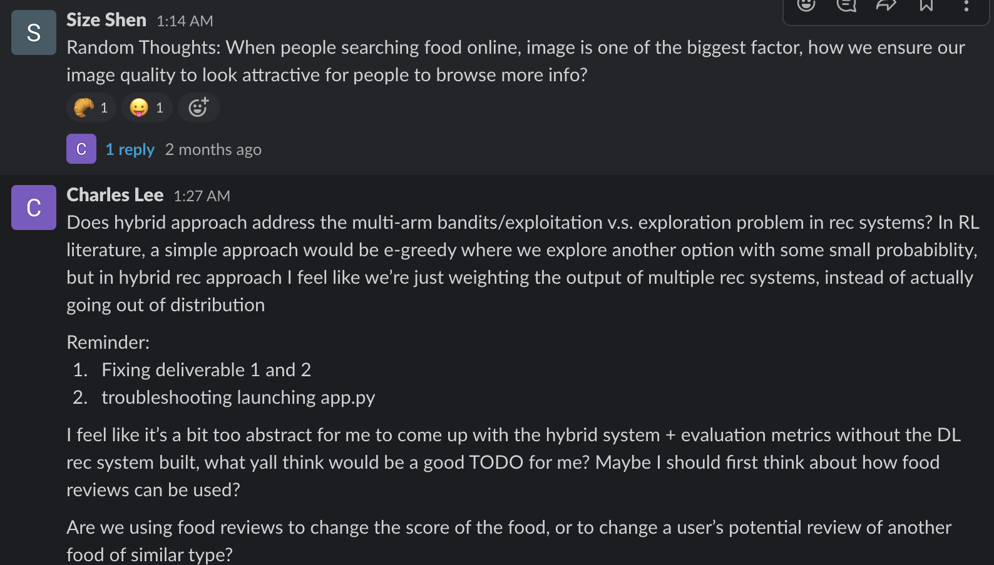
Development Methodology
Agile
Slack

Slide 14
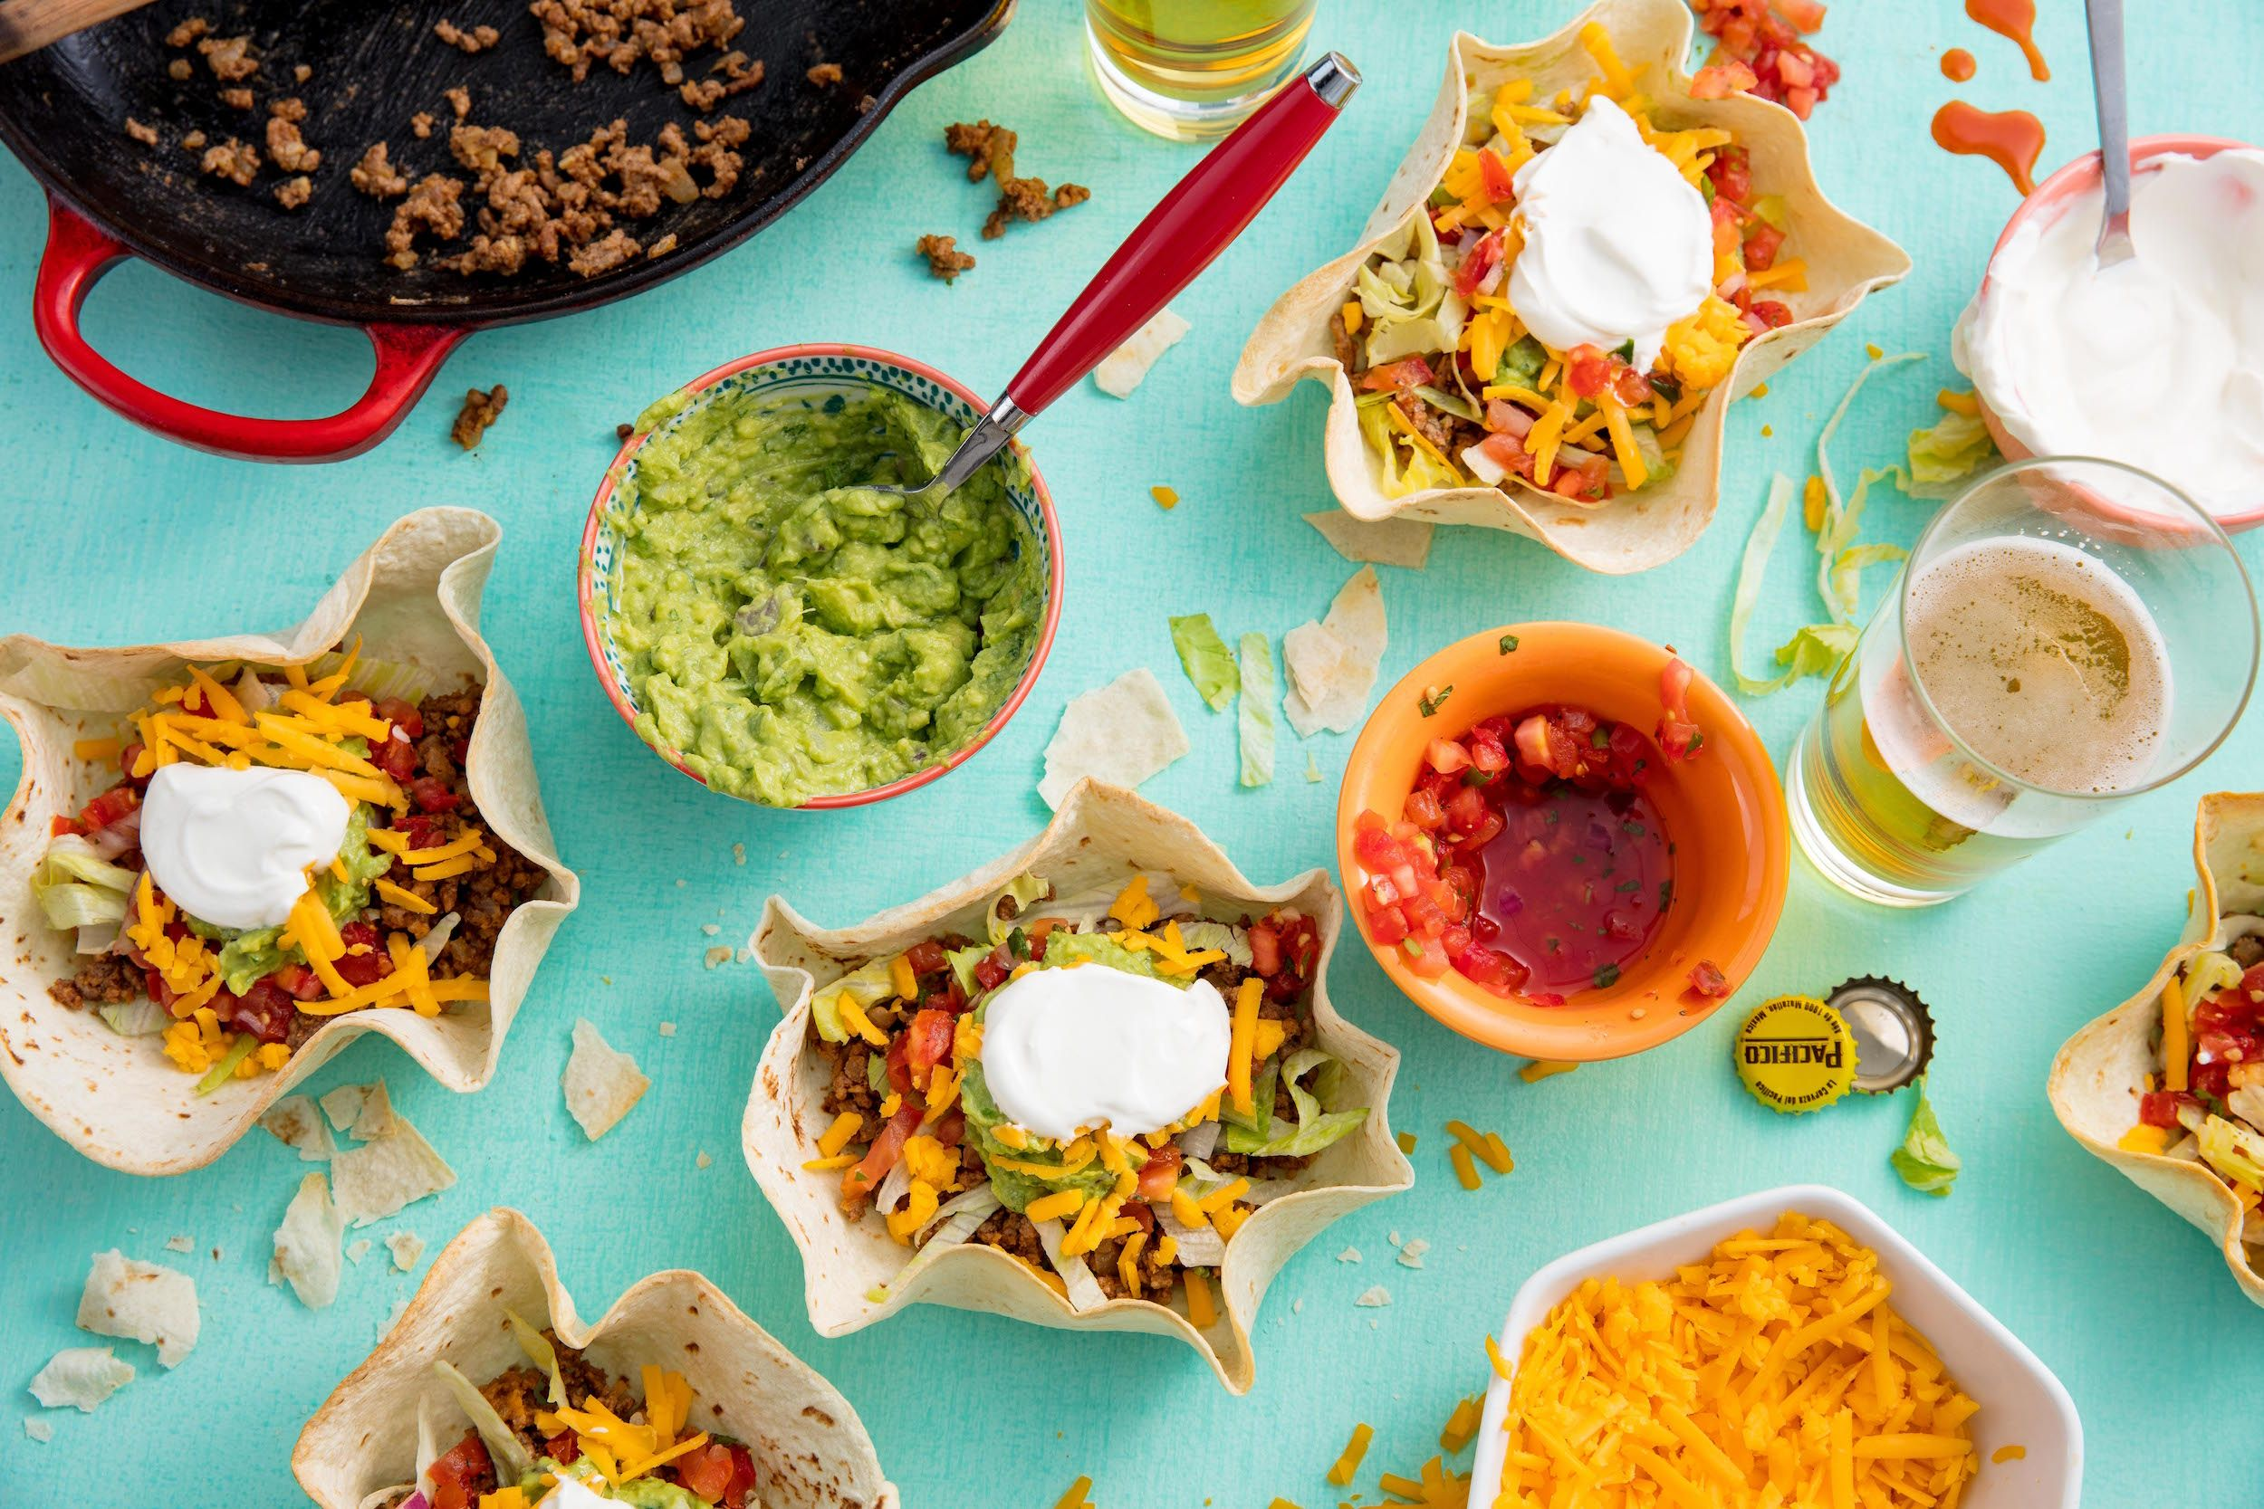
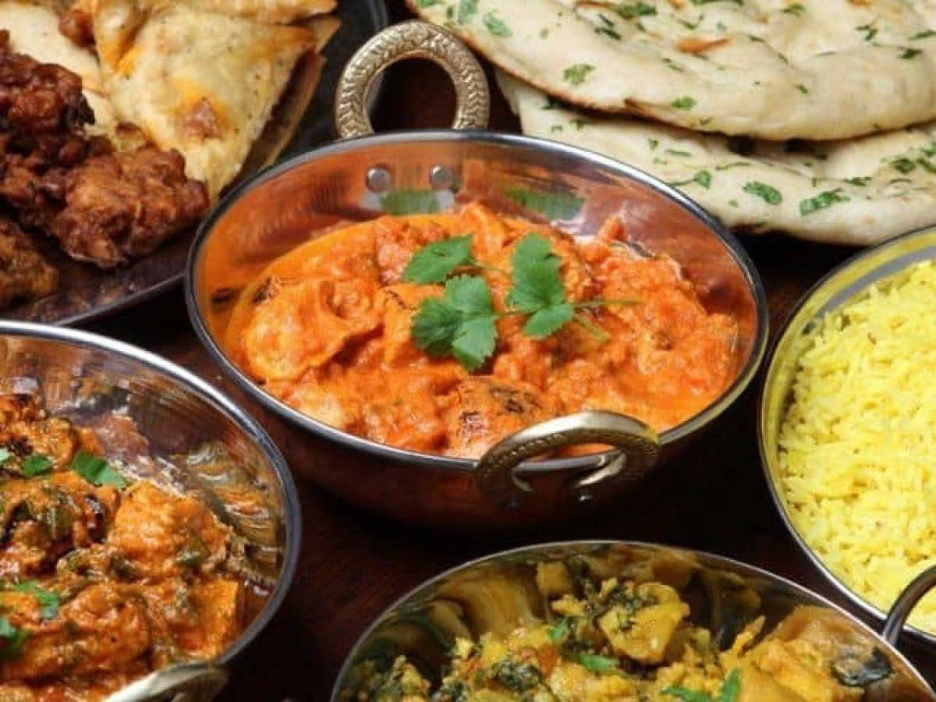
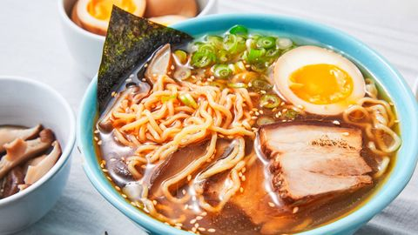
Thank you for Listening!

